Slide 1

Project Presentation
on
Development of Note To Self Android Application using Android Studio
Course code: ICE 4142
Course Title: Mobile Application Development Sessional
Presented To:
Name: Partha Pratim Debnath
Assistant Professor & Head
Dept. of ICE
Presented By:
Name: Masum Billah(01)
Name:Dilruba Khanam(03)
Name :Tasnim Tabassum(09)

Slide 2

TABLE OF CONTENT
Introduction
Algorithm
Codes
Outcomes
Conclusion
1:38:09 AM
2
3
Department of Information and Communication Engineering (ICE)

Slide 3

Introduction
Note to Self is a unique note taking app for Android. Chat like interface makes it one of the simplest notes app for Android, giving you full control of your notes with an option to back up and restore completely offline.
The app supports features like categorization, search functionality, and reminders, making it easy to manage and retrieve notes efficiently.Users can declutter their minds, reduce stress, and focus better on their priorities.
Google Keep, Microsoft OneNote, and Simplenote,
1:32:50 AM
3
1:32:50 AM
3
Department of Information and Communication Engineering (ICE)

Slide 4
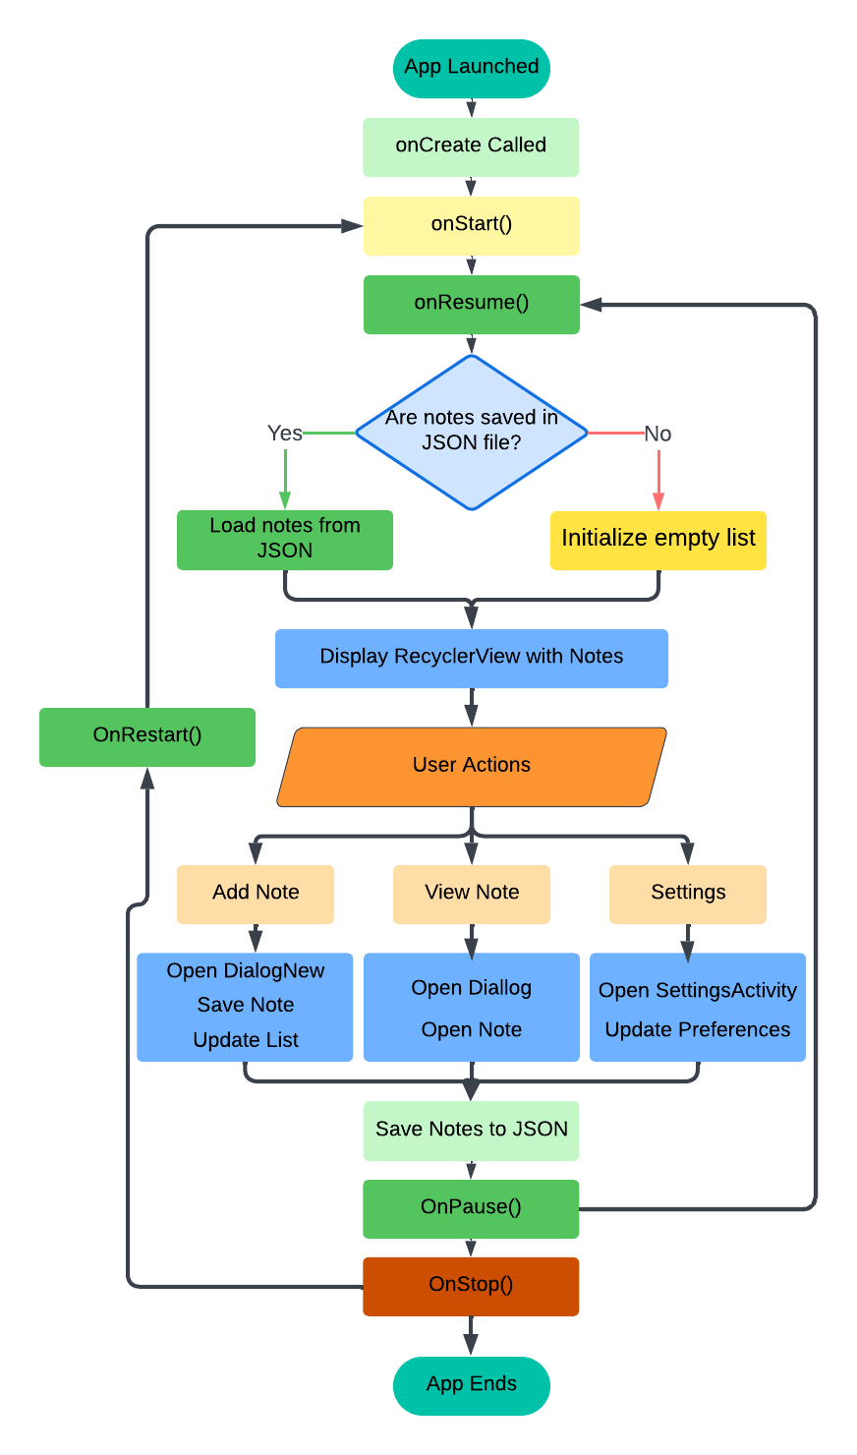
flowchart
Figure: Flowchart of Note to Self app
1:36:35 AM
3
1:36:35 AM
3
Department of Information and Communication Engineering (ICE)

Slide 5

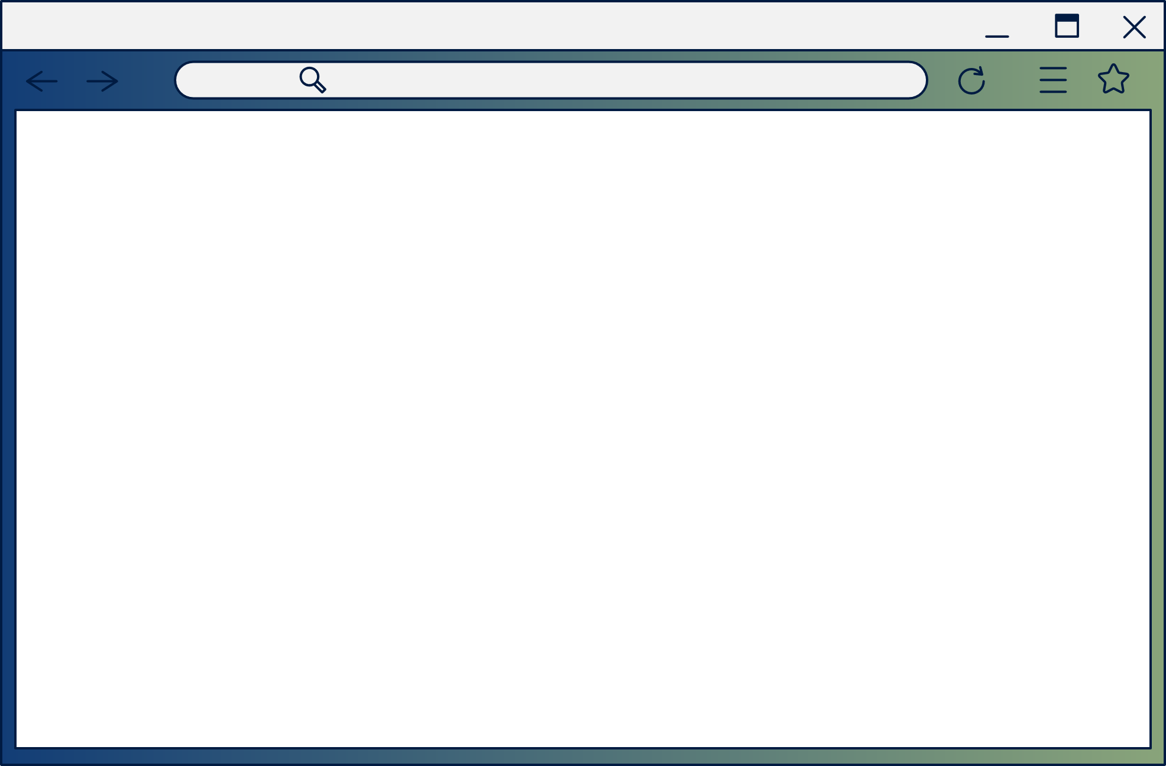
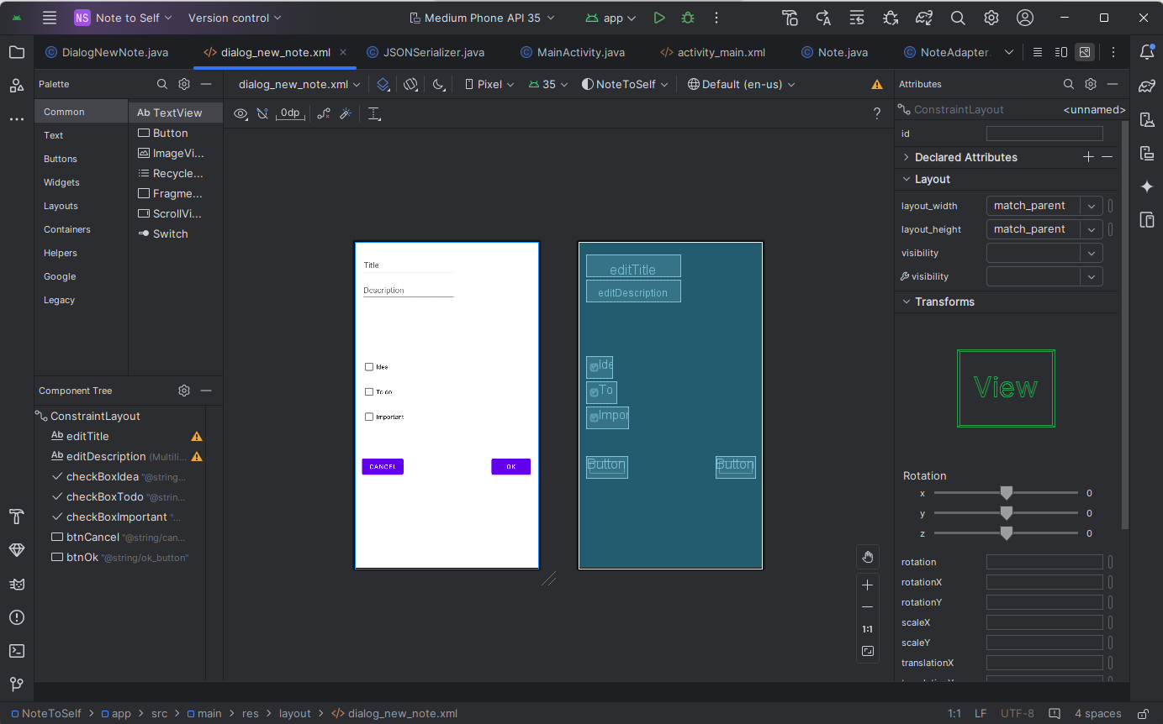
XML CODE
DialogNewNote.xml
1:41:29 AM
3
Department of Information and Communication Engineering (ICE)

Slide 6

JAVA CODE
DialogNewNote.java
public class DialogNewNote extends DialogFragment { @Override public Dialog onCreateDialog(Bundle savedInstanceState) { // All the rest of the code goes here AlertDialog.Builder builder = new AlertDialog.Builder(getActivity()); LayoutInflater inflater = getActivity().getLayoutInflater(); View dialogView = inflater.inflate(R.layout.dialog_new_note, null); final EditText editTitle = dialogView.findViewById(R.id.editTitle); final EditText editDescription =dialogView.findViewById(R.id.editDescription); final CheckBox checkBoxIdea = dialogView.findViewById(R.id.checkBoxIdea); final CheckBox checkBoxTodo = dialogView.findViewById(R.id.checkBoxTodo); final CheckBox checkBoxImportant = dialogView.findViewById(R.id.checkBoxImportant); Button btnCancel = dialogView.findViewById(R.id.btnCancel); Button btnOK = dialogView.findViewById(R.id.btnOk); builder.setView(dialogView).setMessage(R.string.add_new_note); // Handle the cancel button btnCancel.setOnClickListener( new View.OnClickListener() { @Override public void onClick(View v) { dismiss(); }}); builder.setView(dialogView).setMessage(R.string.add_new_note); // Handle the cancel button btnCancel.setOnClickListener( new View.OnClickListener() { @Override public void onClick(View v) { dismiss(); } });
btnOK.setOnClickListener(new View.OnClickListener() { @Override public void onClick(View v) { // Create a new note Note newNote = new Note(); // Set its variables to match the users entries on the form newNote.setTitle(editTitle.getText().toString()); newNote.setDescription(editDescription.getText().toString()); newNote.setIdea(checkBoxIdea.isChecked()); newNote.setTodo(checkBoxTodo.isChecked()); newNote.setImportant(checkBoxImportant.isChecked()); // Get a reference to MainActivity MainActivity callingActivity = (MainActivity) getActivity(); // Pass newNote back to MainActivity callingActivity.NowNote(newNote); // Quit the dialog dismiss(); } }); return builder.create(); } }
1:31:48 AM
3
Department of Information and Communication Engineering (ICE)

Slide 7
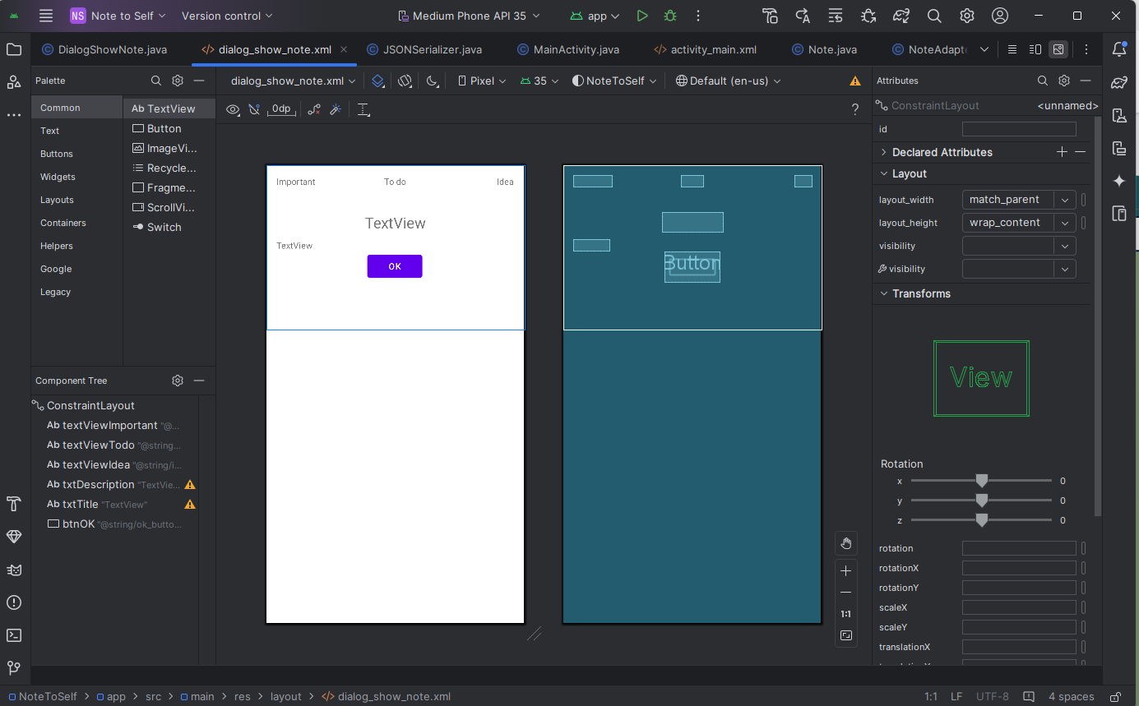
XML CODE
DialogshowNote.xml
1:42:17 AM
3
Department of Information and Communication Engineering (ICE)

Slide 8
JAVA CODE
DialogShowNote.java
package com.example.notetoself; import android.app.AlertDialog; import android.app.Dialog; import android.os.Bundle; import android.view.LayoutInflater; import android.view.View; import android.widget.Button; import android.widget.TextView; import androidx.fragment.app.DialogFragment; import java.util.zip.Inflater; public class DialogShowNote extends DialogFragment { private Note mNote; @Override public Dialog onCreateDialog(Bundle savedInstanceState) { // All the other code goes here AlertDialog.Builder builder = new AlertDialog.Builder(getActivity()); LayoutInflater inflater = getActivity().getLayoutInflater(); View dialogView = inflater.inflate(R.layout.dialog_show_note, null); TextView txtTitle = (TextView) dialogView.findViewById(R.id.txtTitle); TextView txtDescription = (TextView) dialogView.findViewById(R.id.txtDescription); txtTitle.setText(mNote.getTitle()); txtDescription.setText(mNote.getDescription()); TextView txtImportant = (TextView) dialogView.findViewById(R.id.textViewImportant);
TextView txtTodo = (TextView) dialogView.findViewById(R.id.textViewTodo); TextView txtIdea = (TextView) dialogView.findViewById(R.id.textViewIdea); if (!mNote.isImportant()){ txtImportant.setVisibility(View.GONE); } if (!mNote.isTodo()){ txtTodo.setVisibility(View.GONE); } if (!mNote.isIdea()){ txtIdea.setVisibility(View.GONE); } Button btnOK = (Button) dialogView.findViewById(R.id.btnOK); builder.setView(dialogView).setMessage("Your Note"); btnOK.setOnClickListener(new View.OnClickListener() { @Override public void onClick(View v) { dismiss(); } }); return builder.create(); }
1:31:53 AM
3
Department of Information and Communication Engineering (ICE)

Slide 9
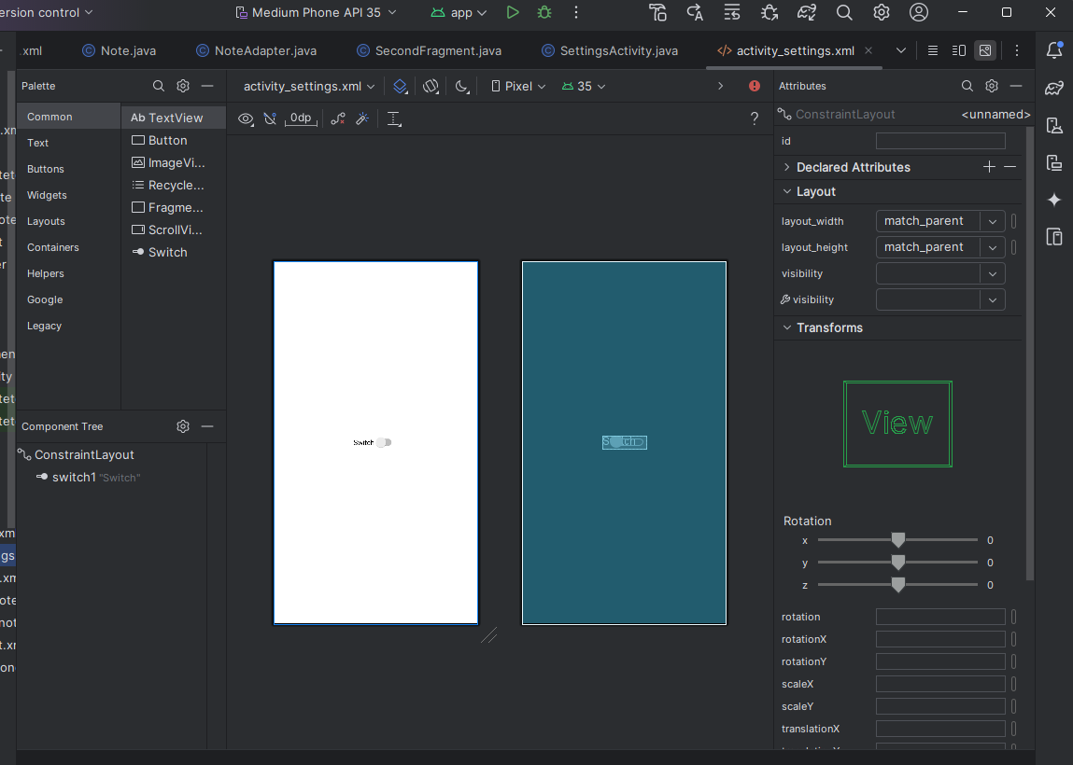
XML CODE
activitysettings.xml
1:42:36 AM
3
Department of Information and Communication Engineering (ICE)

Slide 10
JAVA CODE
SettingsActivity.java
package com.example.notetoself; import androidx.appcompat.app.AppCompatActivity; import android.content.SharedPreferences; import android.os.Bundle; import android.widget.CompoundButton; import android.widget.Switch; public class SettingsActivity extends AppCompatActivity { private SharedPreferences mPrefs; private SharedPreferences.Editor mEdit; private Boolean mShowDividers; @Override protected void onCreate(Bundle savedInstanceState) { super.onCreate(savedInstanceState); setContentView(R.layout.activity_settings); mPrefs = getSharedPreferences("Note to self", MODE_PRIVATE); mEdit = mPrefs.edit(); mShowDividers = mPrefs.getBoolean("deviders", true); Switch switch1 = findViewById(R.id.switch1); switch1.setChecked(mShowDividers);
switch1.setOnCheckedChangeListener(new CompoundButton.OnCheckedChangeListener() { @Override public void onCheckedChanged(CompoundButton buttonView, boolean isChecked) { if(isChecked){ mEdit.putBoolean("dividers", true); mShowDividers = true; }else{ mEdit.putBoolean("dividers", false); mShowDividers = false; } } }); } @Override protected void onPause(){ super.onPause(); mEdit.commit(); } }
1:31:56 AM
3
Department of Information and Communication Engineering (ICE)

Slide 11
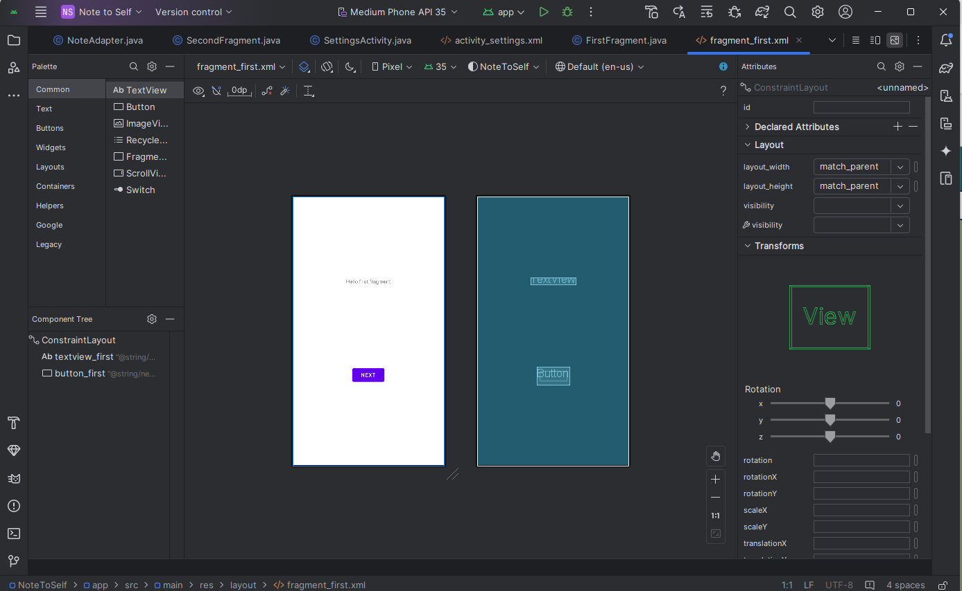
XML CODE
Fragment_first.xml
1:42:52 AM
3
Department of Information and Communication Engineering (ICE)

Slide 12
JAVA CODE
FirstFragment.java
package com.example.notetoself; import android.os.Bundle; import android.view.LayoutInflater; import android.view.View; import android.view.ViewGroup; import androidx.annotation.NonNull; import androidx.fragment.app.Fragment; import androidx.navigation.fragment.NavHostFragment; import com.example.notetoself.databinding.FragmentFirstBinding; public class FirstFragment extends Fragment { private FragmentFirstBinding binding; @Override public View onCreateView( LayoutInflater inflater, ViewGroup container, Bundle savedInstanceState ) { binding = FragmentFirstBinding.inflate(inflater, container, false); return binding.getRoot(); }
public void onViewCreated(@NonNull View view, Bundle savedInstanceState) { super.onViewCreated(view, savedInstanceState); binding.buttonFirst.setOnClickListener(new View.OnClickListener() { @Override public void onClick(View view) { NavHostFragment.findNavController(FirstFragment.this) .navigate(R.id.action_FirstFragment_to_SecondFragment); } }); } @Override public void onDestroyView() { super.onDestroyView(); binding = null; } }
1:32:01 AM
3
Department of Information and Communication Engineering (ICE)

Slide 13

XML CODE
Fragment_second.xml
1:43:05 AM
3
Department of Information and Communication Engineering (ICE)

Slide 14
JAVA CODE
SecondFragment.java
package com.example.notetoself; import android.os.Bundle; import android.view.LayoutInflater; import android.view.View; import android.view.ViewGroup; import androidx.annotation.NonNull; import androidx.fragment.app.Fragment; import androidx.navigation.fragment.NavHostFragment; import com.example.notetoself.databinding.FragmentSecondBinding; public class SecondFragment extends Fragment { private FragmentSecondBinding binding; @Override public View onCreateView( LayoutInflater inflater, ViewGroup container, Bundle savedInstanceState ) { binding = FragmentSecondBinding.inflate(inflater, container, false); return binding.getRoot(); }
public void onViewCreated(@NonNull View view, Bundle savedInstanceState) { super.onViewCreated(view, savedInstanceState); binding.buttonSecond.setOnClickListener(new View.OnClickListener() { @Override public void onClick(View view) { NavHostFragment.findNavController(SecondFragment.this) .navigate(R.id.action_SecondFragment_to_FirstFragment); } }); } @Override public void onDestroyView() { super.onDestroyView(); binding = null; } }
1:32:05 AM
3
Department of Information and Communication Engineering (ICE)

Slide 15
JAVA CODE
JSONSerializer.java
package com.example.notetoself; import android.content.Context; import org.json.JSONArray; import org.json.JSONException; import org.json.JSONTokener; import java.io.BufferedReader; import java.io.FileNotFoundException; import java.io.IOException; import java.util.ArrayList; import java.util.List; public class JSONSerializer { private String mFilename; private Context mContext; public JSONSerializer(String fn, Context con){ mFilename = fn; mContext = con; } public void save(List<Note> notes) throws IOException, JSONException { JSONArray jArray = new JSONArray(); for(Note n: notes){ jArray.put(n.converToJSON());} Writer writer = null; try { OutputStream out = mContext.openFileOutput(mFilename,mContext.MODE_PRIVATE); writer = new OutputStreamWriter(out); writer.write(jArray.toString()); }finally { if(writer!= null){ writer.close(); }} }
public ArrayList<Note> load() throws IOException,JSONException { ArrayList<Note> noteList = new ArrayList<Note>(); BufferedReader reader = null; try { InputStream in = mContext.openFileInput(mFilename); reader = new BufferedReader(new InputStreamReader(in)); StringBuilder jsonString = new StringBuilder(); String line = null; while ((line = reader.readLine()) != null){ jsonString.append(line); } JSONArray jsonArray = (JSONArray) new JSONTokener(jsonString.toString()).nextValue(); for(int i=0; i<jsonArray.length();i++){ noteList.add(new Note(jsonArray.getJSONObject(i))); } }catch (FileNotFoundException e){ }finally { if(reader != null){ reader.close(); } } return noteList; } }
1:32:06 AM
3
Department of Information and Communication Engineering (ICE)

Slide 16
JAVA CODE
Note.java
package com.example.notetoself; import android.content.Context; import org.json.JSONException; import org.json.JSONObject; public class Note { private String mTitle; private String mDiscription; private boolean mIdea; private boolean mTodo; private boolean mImportant; private static final String JSON_TITLE = "title"; private static final String JSON_DESCRIPTION = "description"; private static final String JSON_IDEA = "idea" ; private static final String JSON_TODO = "todo"; private static final String JSON_IMPORTANT = "important"; public Note(){} public Note(JSONObject jo) throws JSONException{ mTitle = jo.getString(JSON_TITLE); mDiscription=jo.getString(JSON_DESCRIPTION); mIdea=jo.getBoolean(JSON_IDEA); mTodo= jo.getBoolean(JSON_TODO); mImportant=jo.getBoolean(JSON_IMPORTANT); } public JSONObject converToJSON() throws JSONException{ JSONObject jo = new JSONObject(); jo.put(JSON_TITLE, mTitle); jo.put(JSON_DESCRIPTION, mDiscription); jo.put(JSON_IDEA, mIdea); jo.put(JSON_TODO, mTodo); jo.put(JSON_IMPORTANT, mImportant); return jo; }
public String getTitle() { return mTitle; } public String getDescription() { return mDiscription; } public boolean isIdea() { return mIdea; } public boolean isTodo() { return mTodo; } public boolean isImportant() { return mImportant; } public void setTitle(String mTitle) { this.mTitle = mTitle; } public void setDescription(String mDiscription) { this.mDiscription = mDiscription; } public void setIdea(boolean mIdea) { this.mIdea = mIdea; } public void setTodo(boolean mTodo) { this.mTodo = mTodo; } public void setImportant(boolean mImportant) { this.mImportant = mImportant; } }
1:32:08 AM
3
Department of Information and Communication Engineering (ICE)

Slide 17
JAVA CODE
NoteAdapter.java
package com.example.notetoself; import android.view.LayoutInflater; import android.view.View; import android.view.ViewGroup; import android.widget.TextView; import androidx.annotation.NonNull; import androidx.recyclerview.widget.RecyclerView; import java.util.List; public class NoteAdapter extends RecyclerView.Adapter<NoteAdapter.ListItemHolder> { private List<Note> mNoteList; private MainActivity mMainActivity; public NoteAdapter(MainActivity mainActivity, List<Note> noteList) { mMainActivity = mainActivity; mNoteList = noteList; } @NonNull @Override public NoteAdapter.ListItemHolder onCreateViewHolder( @NonNull ViewGroup parent, int viewType) { View itemView = LayoutInflater.from(parent.getContext()).inflate(R.layout.listitem, parent, false); return new ListItemHolder(itemView); } @Override public void onBindViewHolder(@NonNull NoteAdapter.ListItemHolder holder, int position) { Note note = mNoteList.get(position); holder.mTitle.setText(note.getTitle()); // Show the first 15 characters of the actual note holder.mDescription.setText(note.getDescription());
if(note.isIdea()){ holder.mStatus.setText(R.string.idea_text); } else if(note.isImportant()){ holder.mStatus.setText(R.string.important_text); } else if(note.isTodo()){ holder.mStatus.setText(R.string.todo_text);}} @Override public int getItemCount() { return mNoteList.size(); } public class ListItemHolder extends RecyclerView.ViewHolder implements View.OnClickListener { TextView mTitle; TextView mDescription; TextView mStatus; public ListItemHolder(View view) { super(view); mTitle = (TextView) view.findViewById(R.id.textViewTitle); mDescription = (TextView) view.findViewById(R.id.textViewDescription); mStatus = (TextView) view.findViewById(R.id.textViewStatus); view.setClickable(true); view.setOnClickListener(this); } @Override public void onClick(View view) { mMainActivity.showNote(getAdapterPosition()); }}}
1:32:10 AM
3
Department of Information and Communication Engineering (ICE)

Slide 18
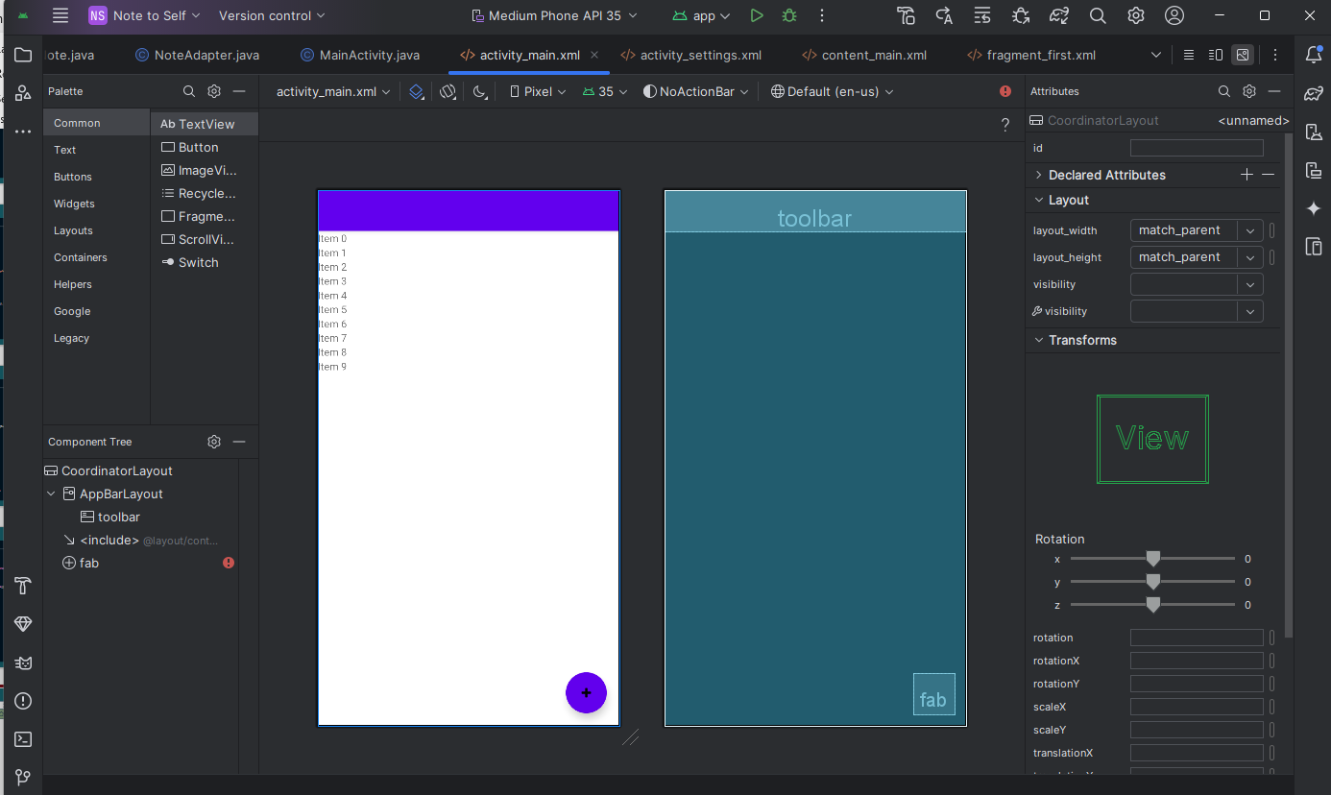
XML CODE
Activity_main.xml
1:43:25 AM
3
Department of Information and Communication Engineering (ICE)

Slide 19
JAVA CODE
MainActivity.java
private RecyclerView recyclerView; private NoteAdapter mAdapter; private boolean mShowDividers; private List<Note> noteList; @Override protected void onCreate(Bundle savedInstanceState) { super.onCreate(savedInstanceState); setContentView(R.layout.activity_main); Toolbar toolbar = (Toolbar) findViewById(R.id.toolbar); setSupportActionBar(toolbar); FloatingActionButton fab = (FloatingActionButton)findViewById(R.id.fab); fab.setOnClickListener(new View.OnClickListener() { @Override public void onClick(View view) { DialogNewNote dialog = new DialogNewNote(); dialog.show(getSupportFragmentManager(),"");}})} mSerializer = new JSONSerializer("NoteToSelf.json",getApplicationContext()); try { noteList = mSerializer.load(); }catch (Exception e){ noteList = new ArrayList<Note>(); Log.e("Error loading notes: ", "",e);} recyclerView = findViewById(R.id.recyclerView); mAdapter = new NoteAdapter(this, noteList); RecyclerView.LayoutManager mLayoutManager = new LinearLayoutManager(getApplicationContext()); recyclerView.setLayoutManager(mLayoutManager); recyclerView.setItemAnimator(new DefaultItemAnimator()); recyclerView.addItemDecoration(new DividerItemDecoration(this, LinearLayoutManager.VERTICAL)); recyclerView.setAdapter(mAdapter);}
package com.example.notetoself; import android.content.Intent; import android.content.SharedPreferences; import android.os.Bundle; import com.google.android.material.floatingactionbutton.FloatingActionButton; import com.google.android.material.snackbar.Snackbar; import androidx.appcompat.app.AppCompatActivity; import android.util.Log; import android.view.View; import androidx.appcompat.widget.Toolbar; import androidx.navigation.NavController; import androidx.navigation.Navigation; import androidx.navigation.ui.AppBarConfiguration; import androidx.navigation.ui.NavigationUI; import androidx.recyclerview.widget.DefaultItemAnimator; import androidx.recyclerview.widget.DividerItemDecoration; import androidx.recyclerview.widget.LinearLayoutManager; import androidx.recyclerview.widget.RecyclerView; import com.example.notetoself.databinding.ActivityMainBinding; import android.view.Menu; import android.view.MenuItem; import android.widget.Button; import android.widget.LinearLayout; import java.util.ArrayList; import java.util.List; public class MainActivity extends AppCompatActivity {
private SharedPreferences mPrefs; private JSONSerializer mSerializer;
1:32:14 AM
3
Department of Information and Communication Engineering (ICE)

Slide 20
JAVA CODE
MainActivity.java
@Override protected void onResume(){ super.onResume(); mPrefs = getSharedPreferences("Note to self", MODE_PRIVATE); mShowDividers = mPrefs.getBoolean("dividers", true); if(mShowDividers){ recyclerView.addItemDecoration(new DividerItemDecoration(this, LinearLayoutManager.VERTICAL)); }else{ if(recyclerView.getItemDecorationCount()>0){ recyclerView.removeItemDecorationAt(0); } } } public void saveNote(){ try { mSerializer.save(noteList); }catch (Exception e){ Log.e("Error saving notes","",e);}} @Override protected void onPause(){ super.onPause(); saveNote(); } }
public void NowNote(Note n){ noteList.add(n); mAdapter.notifyDataSetChanged();} @Override public boolean onCreateOptionsMenu(Menu menu) { // Inflate the menu; this adds items to the action bar if it is present. getMenuInflater().inflate(R.menu.menu_main, menu); return true;} @Override public boolean onOptionsItemSelected(MenuItem item) { int id = item.getItemId(); /noinspection SimplifiableIfStatement if (id == R.id.action_settings) { Intent intent = new Intent(this, SettingsActivity.class); startActivity(intent); return true; } return super.onOptionsItemSelected(item); } public void showNote(int noteToShow){ DialogShowNote dialog = new DialogShowNote(); dialog.sendNoteSelected(noteList.get(noteToShow)); dialog.show(getSupportFragmentManager(), ""); }
1:32:16 AM
3
Department of Information and Communication Engineering (ICE)

Slide 21
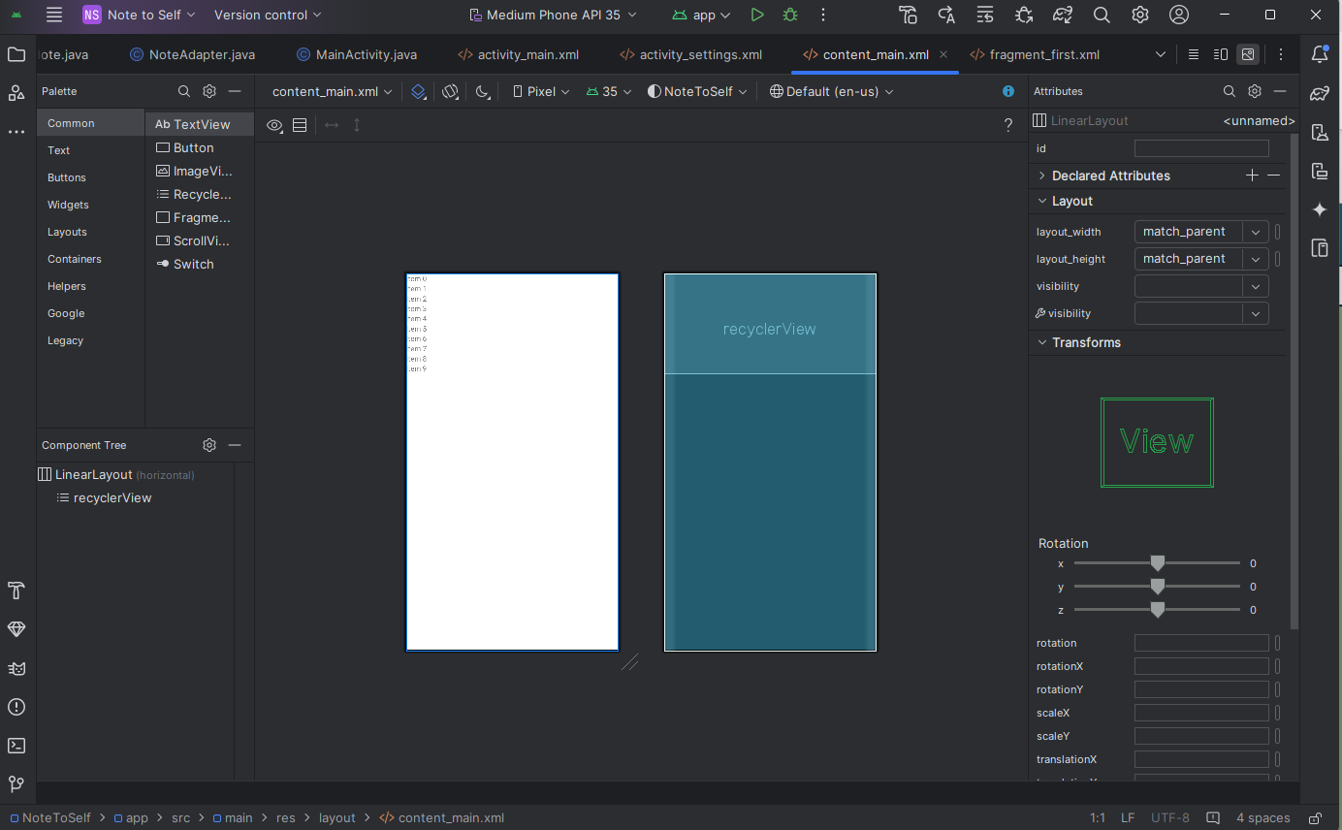
XML CODE
CONTENT_MAIN.xml
1:43:37 AM
3
Department of Information and Communication Engineering (ICE)

Slide 22
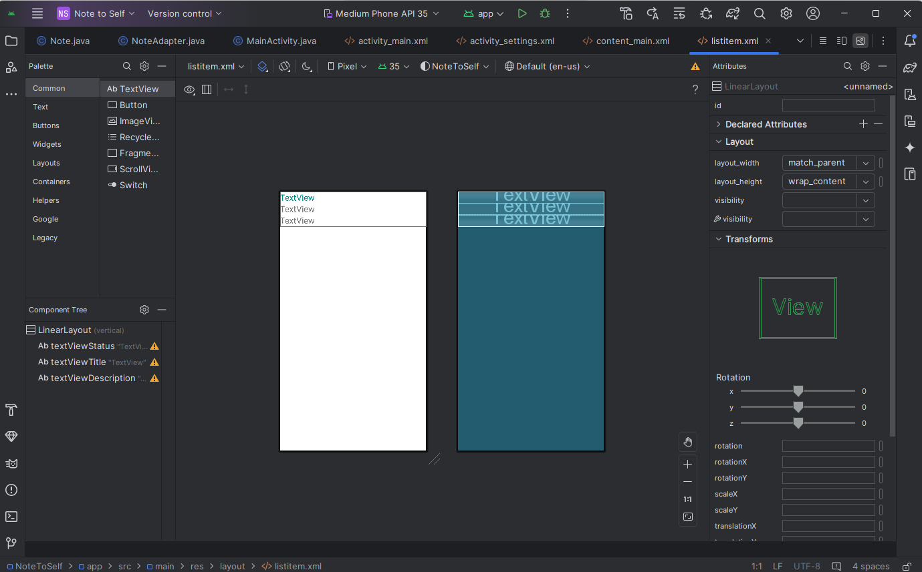
XML CODE
listterm.xml

Slide 23
XML CODE
String.XML
<resources xmlns:tools="http://schemas.android.com/tools"> <string name="app_name">Note to Self</string> <string name="action_settings">Settings</string> <!-- Strings used for fragments for navigation --> <string name="first_fragment_label" tools:ignore="MissingTranslation">First Fragment</string> <string name="second_fragment_label" translatable="false">Second Fragment</string> <string name="next" translatable="false">Next</string> <string name="previous" translatable="false">Previous</string> <string name="hello_first_fragment" translatable="false">Hello first fragment</string> <string name="hello_second_fragment" translatable="false">Hello second fragment. Arg: %1$s</string> <string name="action_add">add</string> <string name="title_hint">Title</string>
<string name="title_txt" translatable="false">Name</string> <string name="description_hint">Description</string> <string name="idea_text">Idea</string> <string name="important_text">Important</string> <string name="todo_text">To do</string> <string name="cancel_button">Cancel</string> <string name="ok_button">OK</string> <string name="add_new_note">Add a new note</string> <string name="settings_title">Settings</string> <string name="theme_title" translatable="false">Theme</string> <string name="theme_light" translatable="false">Light</string> <string name="theme_dark" translatable="false">Dark</string> </resources>
1:32:18 AM
3
Department of Information and Communication Engineering (ICE)

Slide 24
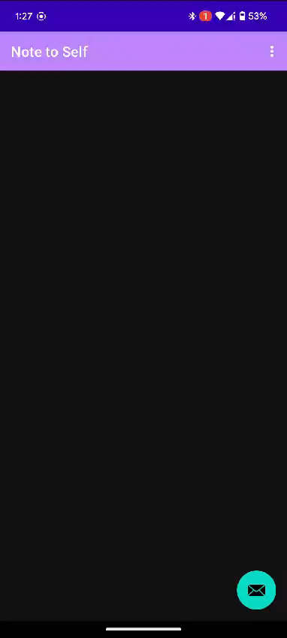

outcome
1:35:57 AM
2
3
Department of Information and Communication Engineering (ICE)
Violence Detection

Slide 25
cONclUSION
01
The Note To Self application empowers users to organize their thoughts, reminders, and plans efficiently
Designed to help users easily jot down and manage notes, enhancing their daily organization.
02
The Note To Self app is more than a digital notebook; It is a tool that fosters personal growth and efficiency
03
1:36:14 AM
3
Department of Information and Communication Engineering (ICE)

Slide 26
Thank You
1:32:30 AM
3
Department of Information and Communication Engineering (ICE)

Slide 27
Any
Questions?
1:32:36 AM
3
Department of Information and Communication Engineering (ICE)

